Slide 1
Turtlebot – Hand gesture and voice control
-Rammya Iyer
-Pushpinder Walia
-Nikhil Arora

Slide 2
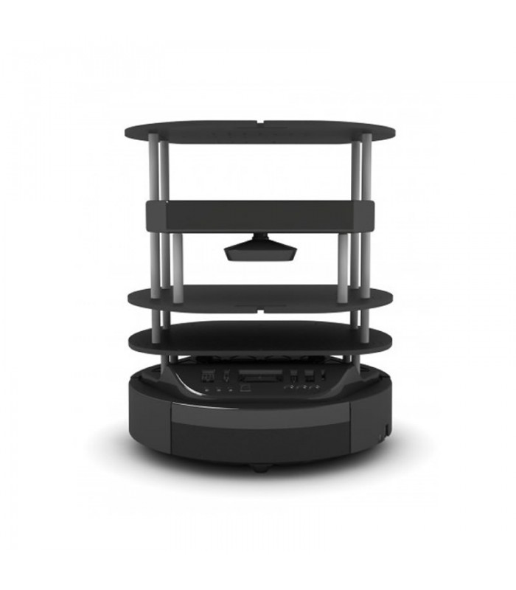
Introduction
Our project, is primarily based on establishing this very base by including the feature of controlling a robot by using one’s voice commands or by hand gesture movement.

Slide 3
Motivation
Always thought how difficult it would be for a differently abled person to work in the real world. So, from there we thought that why not make a robot which they can use as a assistant using their gestures or voice commands.

Slide 4
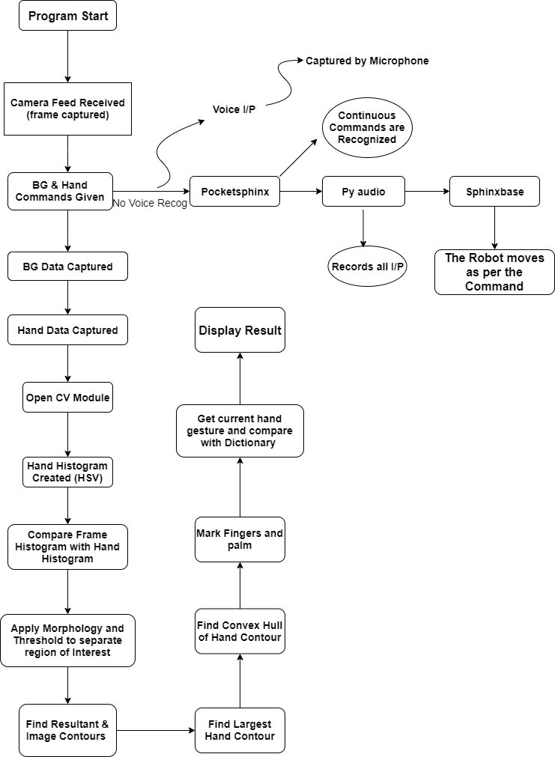
Hand Gesture

Slide 5
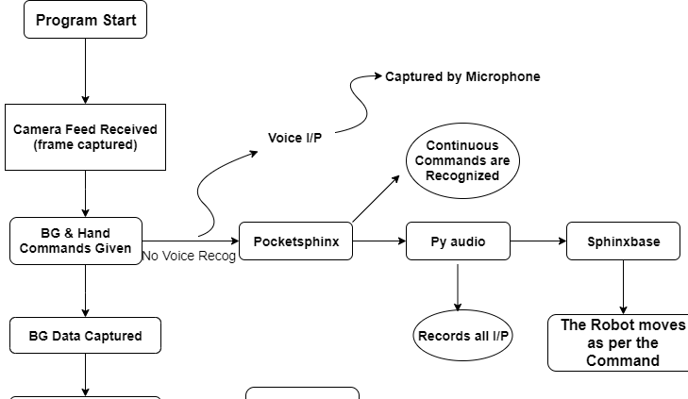
Voice Control

Slide 6
Final Video
final.mp4

Slide 7
THANK YOU

